Slide 1
Network+ Guide to Networks Eighth Edition
Chapter 12
Wide Area Networks
© 2019 Cengage. All Rights Reserved. May not be copied, scanned, or duplicated, in whole or in part, except for use as permitted in a license distributed with a certain product or service or otherwise on a password-protected website for classroom use.

Slide 2
Objectives
12.1 Identify the fundamental elements of WAN service options
12.2 Compare and contrast Layer 1 WAN technologies
12.3 Compare and contrast Layer 2 WAN technologies
12.4 Explain the most common wireless WAN technologies

Slide 3
WAN Essentials (1 of 2)
WAN
Network traversing significant distance, connecting LANs
Type of WAN needed depends upon:
Traffic load
Budget
Geographic breadth
Commercially available technology

Slide 4
WAN Essentials (2 of 2)
WAN and LAN differences:
LANs connect nodes; WANs connect networks spread over wide geographic area
Both LANs and WANs use the same protocols from Layer 3 and higher
Differ at Layers 1 and 2 access methods, topologies, and media
LAN wiring: privately owned
WANs: owned and operated by telcos (telecommunications carriers), also known as NSPs (network service providers)
Examples: AT&T, Verizon, Charter, and Comcast

Slide 5
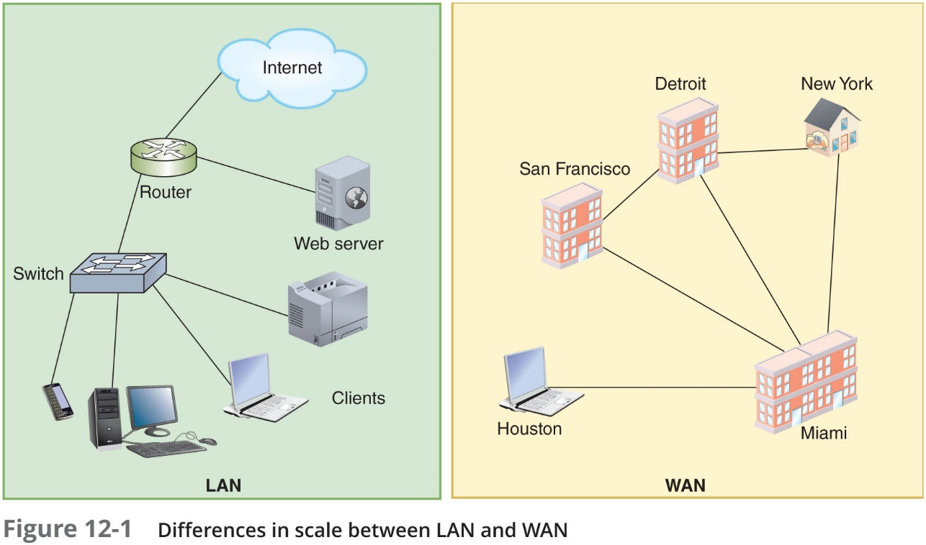
Data Transfer Methods (1 of 4)
WAN link
Connection between one WAN site (endpoint) and another site
Can be point-to-point (one site to only one site) or multipoint (one site to two or more other sites)

Slide 6
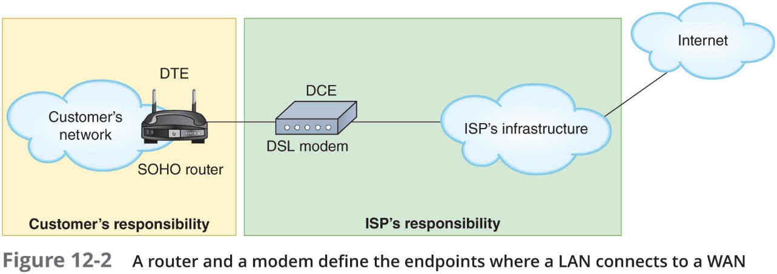
Data Transfer Methods (2 of 4)
Data terminal equipment (D T E)
Customer’s endpoint device on the WAN
Communicates on the LAN
Data communications equipment (D C E)
Carrier’s endpoint device for the WAN
Communicates on the WAN

Slide 7
Data Transfer Methods (3 of 4)
Primary categories of WAN connections:
Dedicated line—A cable or other telecommunications path has continuously available communications channels and is not shared with other users
Virtual circuit—WAN connection logically appears to the customer to be dedicated, but, physically can be any configuration through the carrier’s cloud
P V C (permanent virtual circuit)
S V C (switched virtual circuit)
Switching determines how connections are created between nodes on a network
Circuit-switched—Connection is established between two nodes before they begin transmitting data
Packet-switched—Data is broken into packets before it’s transported

Slide 8
Data Transfer Methods (4 of 4)
Table 12-1 Overview of wired WAN technologies
Functions at O S I Layer 1 | Functions at O S I Layer 2 | Primary media
Dial-up over P S T N | PPP | Copper
I S D N over P S T N | PPP or frame relay | Copper
D S L | PPP, Ethernet, or A T M | Copper or fiber optic
Cable broadband | Cable broadband, Ethernet | Copper and fiber optic
Metro Ethernet | Ethernet, M P L S | Copper, fiber optic, or wireless
T-carriers | PPP, frame relay, or A T M | Copper or fiber optic
SONET | PPP, frame relay, A T M, M P L S | Fiber-optic

Slide 9
Troubleshooting an Internet Connection (1 of 2)
There are steps to take when troubleshooting a problem with a WAN connection
Before calling your I S P
Preventative measures can be implemented to avoid having the problem in the first place
Need to know the difference between I S P’s equipment and subscriber’s equipment located at the customer’s premises, regardless of who owns it and who is responsible, is called customer premise equipment (C P E)
Equipment belonging to the ISP should only be serviced by the I S P’s technicians
Even if located on the customer’s side of demark (demarcation point)

Slide 10
Troubleshooting an Internet Connection (2 of 2)
Devices commonly found at or near the demarc:
N I U (network interface unit)
Smart jack—A more intelligent version of an N I U and can provide diagnostic information
Line driver
C S U/D S U
Common issues to look for:
Interface error
D N S issues
Router misconfiguration
Interference

Slide 11
Layer 1 WAN Technologies
Physical layer services are generally performed by Layer 1 standards such as:
D S L, I S D N, SONET, and T-carrier links
Broadband:
Cables and bandwidth are shared between multiple customers
I S P makes a “best effort” attempt to provide up to advertised bandwidth
Bandwidth is asymmetrical (asynchronous)
Download speeds are faster than upload speeds
D I A (dedicated internet access):
Dedicated to a single customer
Bandwidth is symmetrical (synchronous)
Download and upload speeds are the same
Important for businesses that back up large amounts of data online

Slide 12
P S T N (Public Switched Telephone Network) (1 of 3)
P S T N (public switched telephone network):
Circuit-switching network of lines, carrier equipment providing telephone service
Also called P O T S (plain old telephone service)
Originally: Analog traffic
Today: Digital data, computer controlled switching
C O (central office):
Where telephone company terminates lines
Switches calls between different locations

Slide 13
P S T N (Public Switched Telephone Network) (2 of 3)
Local loop (last mile)
Portion of the P S T N connecting residence or business to nearest CO
N I U (network interface unit)
Termination point at customer’s demarcation point
Three examples of P S T N-based network technologies:
Dial-up
I S D N
D S L
Dial-up and I S D N are mostly obsolete
Important building-blocks for understanding later technologies

Slide 14
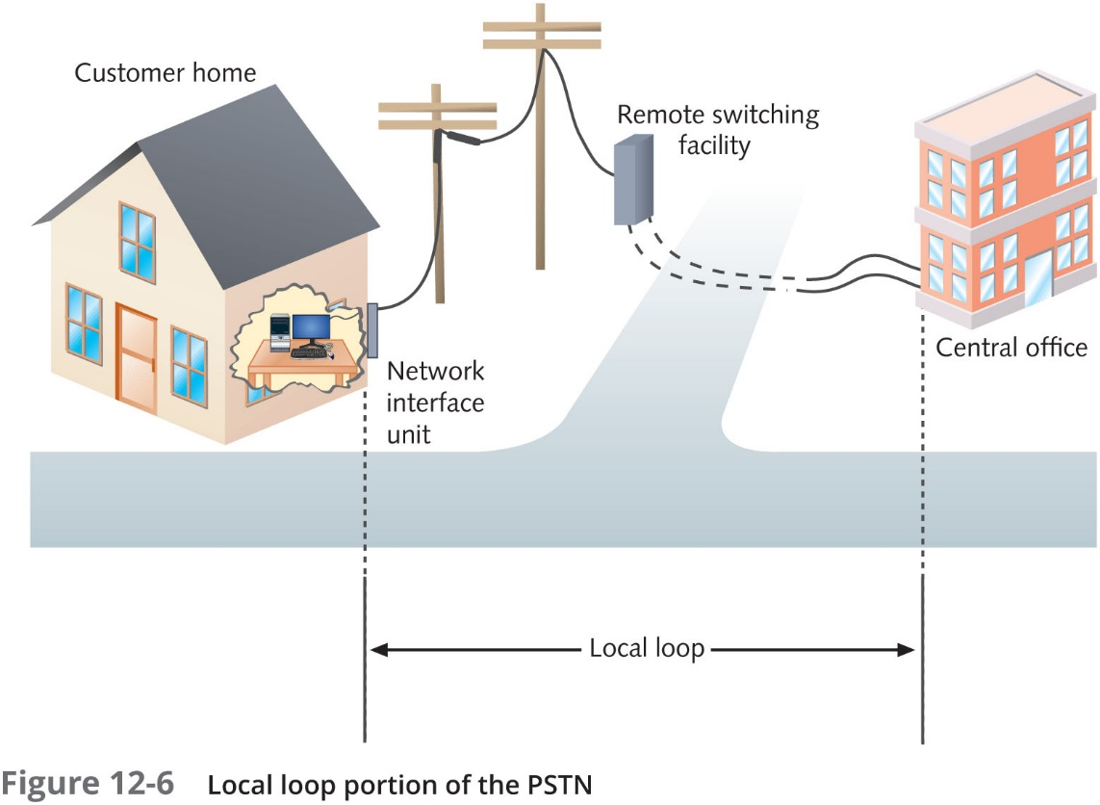
P S T N (Public Switched Telephone Network) (3 of 3)

Slide 15
D S L (Digital Subscriber Line) (1 of 4)
Operates over P S T N
Directly competes with cable broadband and T1 services
Requires repeaters for longer distances
Distance between the customer and C O affect actual throughput
Supports multiple data, voice channels
Over a single line
Uses advanced data modulation techniques:
Data signal alters carrier signal properties
Amplitude or phase modulation

Slide 16
D S L (Digital Subscriber Line) (2 of 4)
Types of D S L
X D S L refers to all D S L varieties
Better-known D S L varieties:
A D S L (asymmetric D S L)—Faster download speeds than upload speeds
Most common form of D S L
Best use: video conferencing, web surfing
V D S L (very high bit rate D S L or variable D S L)
Faster than ADSL and also asymmetric
S D S L (symmetric D S L)—Has equal download and upload speeds maxing out around 2 Mbps
Best use: uploading, downloading significant data amounts

Slide 17
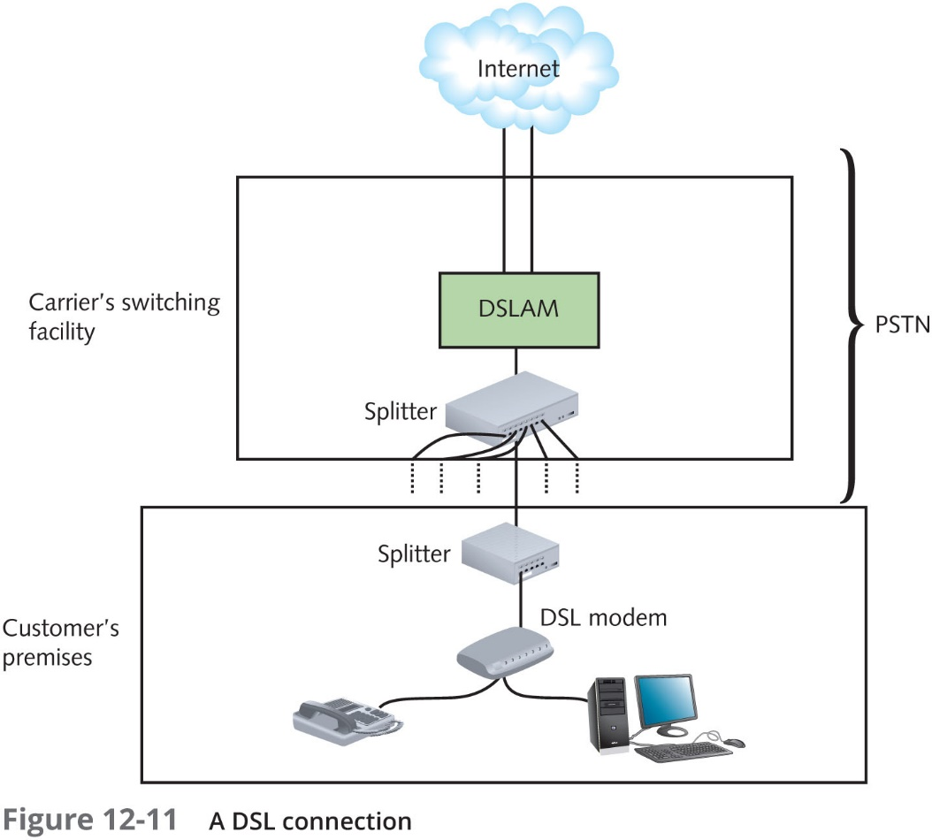
D S L (Digital Subscriber Line) (3 of 4)
D S L equipment

Slide 18
D S L (Digital Subscriber Line) (4 of 4)
Path of an A D S L connection:
Establish T C P connection
Transmit through D S L modem:
Internal or external
Splitter separates incoming voice, data signals
May connect to switch or router
D S L modem forwards modulated signal to local loop:
Signal continues over four-pair U T P wire
Distance less than 18,000 feet: signal combined with other modulated signals in telephone switch
Carrier’s remote switching facility:
Splitter separates data signal from voice signals
Request sent to D S L A M (D S L access multiplexer)
Request issued from carrier’s network to Internet backbone

Slide 19
Cable Broadband (1 of 3)
Cable companies connectivity option
Based on coaxial cable wiring used for TV signals
Standardized by an international cooperative effort
Suite of specifications called D O C S I S (Data Over Cable Service Interface Specifications)
Typically offered at asymmetric speeds
Up to 70 Mbps download and 7 Mbps upload
Newest D O C I S standard 3.1 allows for full duplex or symmetric speeds
Up to 10 Gbps in both directions
Best uses
Web surfing or network data download

Slide 20
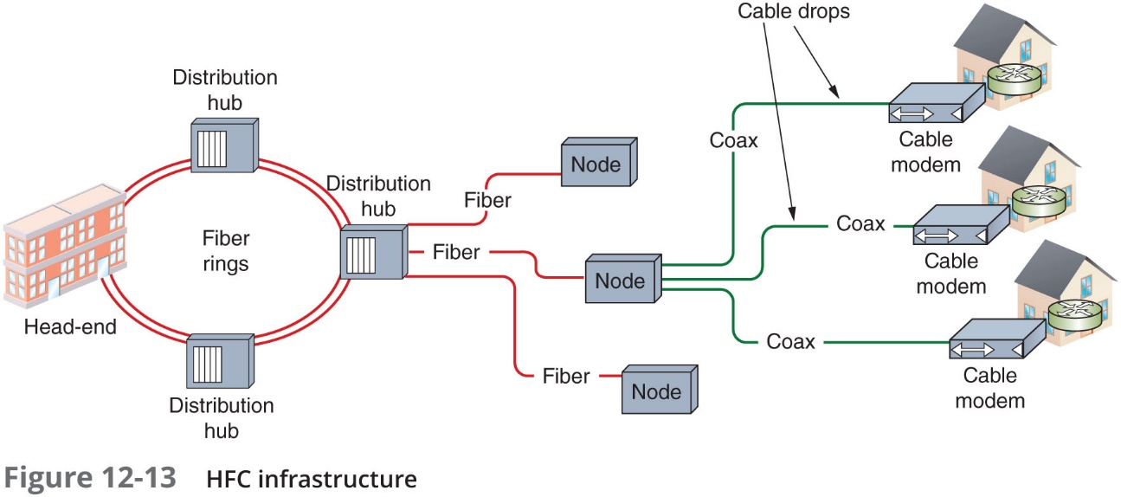
Cable Broadband (2 of 3)
Many cable companies employ fiber cabling for a significant portion of their physical infrastructure
H F C (hybrid fiber coaxial) network use fiber-optic cabling to connect the cable company’s distribution center, to distribution hubs and then to optical nodes near customers

Slide 21
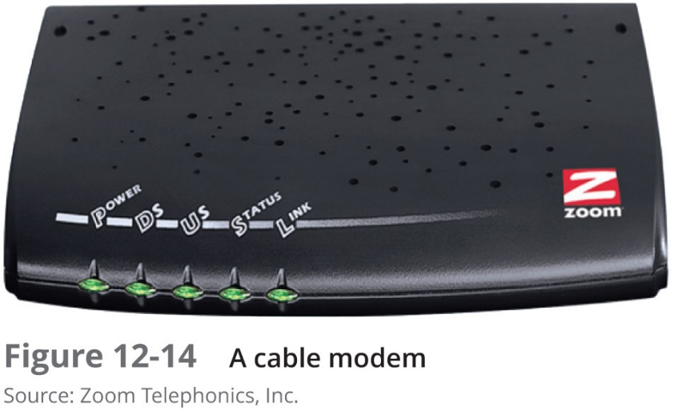
Cable Broadband (3 of 3)
Cable modem:
Modulates, demodulates transmission, reception signals via cable wiring
Operates at Physical and Data Link layers
May connect to connectivity device
Provides dedicated connection
Many subscribers share same local line, throughput

Slide 22
Metro (Metropolitan) Ethernet (1 of 3)
Metro Ethernet Forum (M E F):
An alliance of over 220 industry organizations worldwide
Developing ways to send Ethernet traffic across MAN and WAN connections
Carrier-Ethernet Transport (C E T)
An Ethernet-based transport solution designed to overcome weaknesses of implementing Ethernet outside the LAN environment

Slide 23
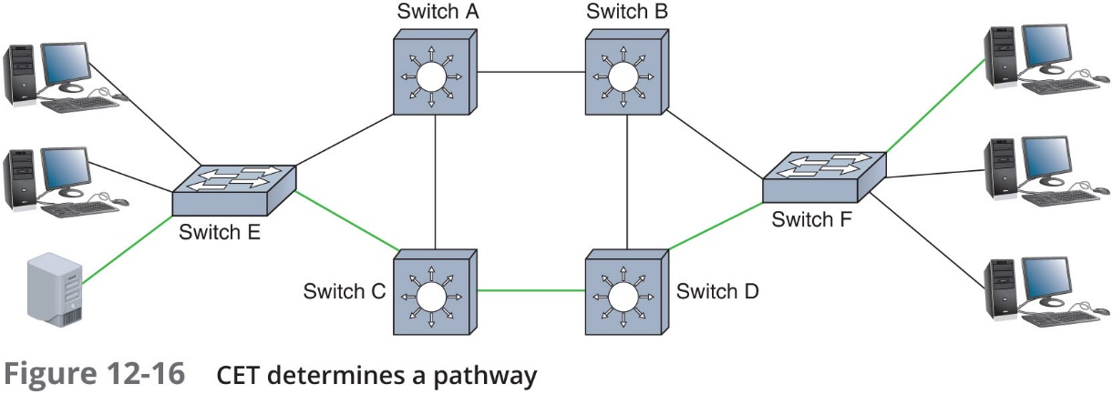
Metro (Metropolitan) Ethernet (2 of 3)

Slide 24
Metro (Metropolitan) Ethernet (3 of 3)
Metro Ethernet advantages:
Streamlined connections
Cost efficiency
Scalability
Familiarity
Hardware

Slide 25
T-Carriers (1 of 5)
T-carrier technology includes:
T1s, fractional T1s, and T3s
AT&T developed T-carrier technology in 19 57
Medium
Specially conditioned copper wire, fiber-optic cable, and wireless links

Slide 26
T-Carriers (2 of 5)
Types of T-carrier lines
T1—Connects branch offices, connects to carrier
T-carrier standards (T-C X R standards) uses T D M (time division multiplexing) over two wire pairs to divide a single channel into multiple channels
T3—Provides 28 times more throughput than a T1
More expensive than T1s
Used by more data-intensive businesses
Fractional T1—Allows organizations to use only some of the channels on a T1 line
Charged according to the number of channels they use

Slide 27
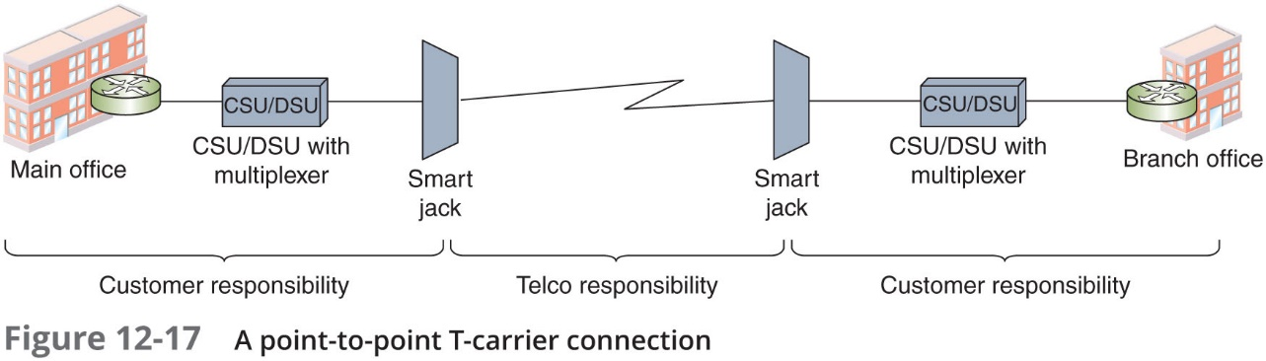
T-Carriers (3 of 5)
Voice services optimization—T1s support voice services in two ways:
I S D N P R I—T1 line with channels slightly reorganized
S I P (Session Initial Protocol) trunk
S I P trunking employs VoIP to create virtual connections over an existing data service
T-carrier equipment

Slide 28
T-Carriers (4 of 5)
T-carrier equipment (continued)
Smart jack—Terminates a T-carrier line at the customer’s demark and functions as a monitoring point for the connection
C S U/D S U—Serves as the D T E (data terminal equipment) or endpoint device for a leased line
C S U provides termination for the digital signal
D S U converts T-carrier frames into frames the LAN can interpret (and vice versa)
Multiplexer—Combines multiple signals from a LAN for transport over the T-carrier line
Separates an incoming T-carrier line’s combined channels into individual signals that can be interpreted

Slide 29
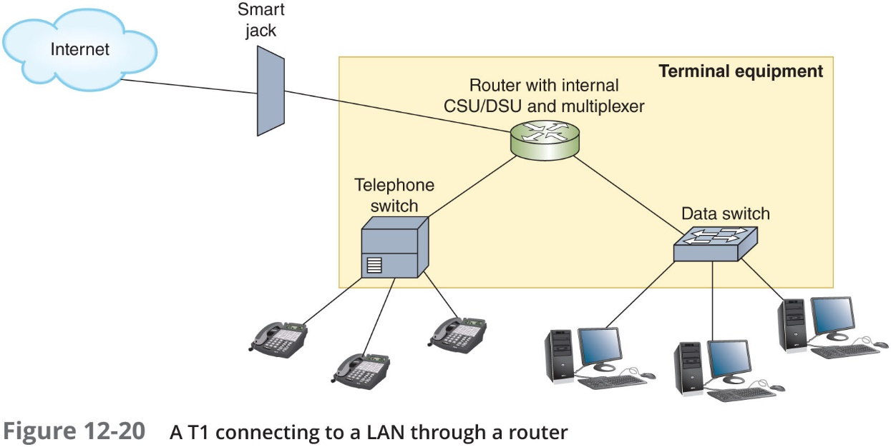
T-Carriers (5 of 5)

Slide 30
SONET (Synchronous Optical Network) (1 of 4)
SONET—A high-bandwidth WAN signaling technique
Key strengths:
WAN technology interoperability
Fast data transfer rates
Simple link additions, removals
High degree of fault tolerance (self-healing)
Considered the best choice for linking WANS between North America, Europe, and Asia
Internationally, SONET is known as S D H (Synchronous Digital Hierarchy)

Slide 31
SONET (Synchronous Optical Network) (2 of 4)
SONET often traverses multiple ISP networks
Connecting networks through the Internet backbone
On the transmitting end, SONET multiplexers accept input from different network types
Format the data in a standard SONET frame
Multiplexer combines individual SONET signals on the transmitting end
A demultiplexer on the receiving end separates combined signals and translates incoming signals back into their original form

Slide 32
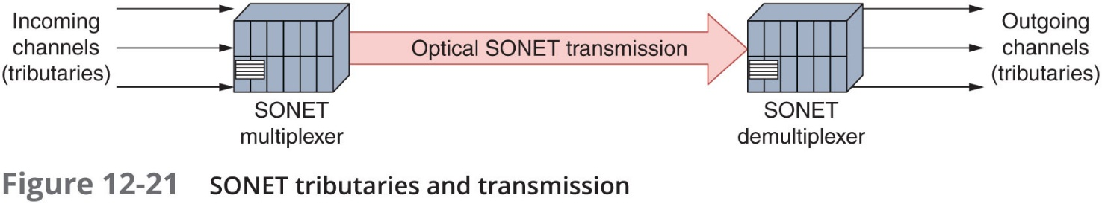
SONET (Synchronous Optical Network) (3 of 4)

Slide 33
SONET (Synchronous Optical Network) (4 of 4)
SONET’s transmissions rely on a timing scheme
Frames will travel without data rather than disrupt the schedule
SONET frames are a consistent size
Include information indicating where the payload begins
Data rate of a SONET connection is indicated by its O C (Optical Carrier) level
Commonly used by:
Large companies
Long-distance companies linking metropolitan areas and countries
I S Ps that want to guarantee fast, reliable access to the Internet
Telephone companies connecting their C Os

Slide 34
Layer 2 WAN Technologies
Some Layer 2 technologies do traverse the I S P’s network
In order to connect two or more LANs across a WAN connection
Three technologies:
Frame relay
A T M (Asynchronous Transfer Mode)
M P L S (multiprotocol label switching)

Slide 35
Frame Relay (1 of 3)
Frame relay:
Group of Layer 2 protocols originally designed as a fast packet-switched network over I S D N
Today is used as the Data Link protocol for various circuit interfaces and media
Data-link connection identifier (D L C I)
Identifier routers read to determine which circuit to use for the frame
Frame relay is a connection-oriented protocol

Slide 36
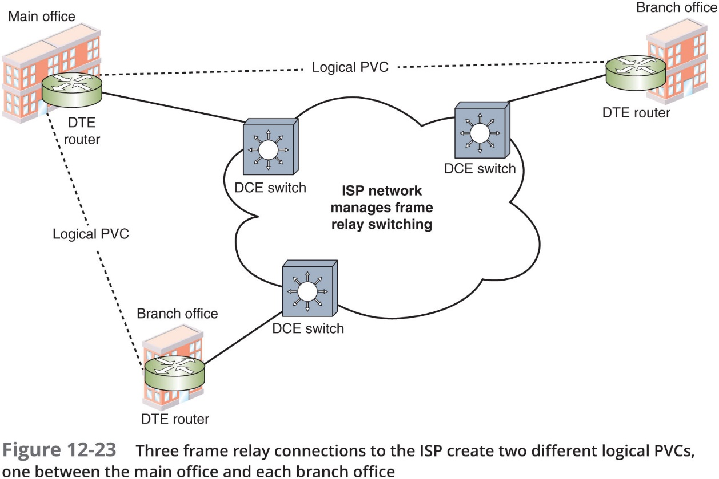
Frame Relay (2 of 3)

Slide 37
Frame Relay (3 of 3)
P V C (permanent virtual circuit)
Connections established before data needs to be transmitted and are maintained after transmission
Advantage:
Pay for only the amount of bandwidth required
Less expensive than other WAN technologies

Slide 38
A T M (Asynchronous Transfer Mode) (1 of 3)
Functions at the Data Link layer
Asynchronous communications method:
Nodes do not conform to predetermined schemes
Specifying data transmissions timing
Each character transmitted
Start and stop bits
Specifies Data Link layer framing techniques
Fixed packet size
Packet (cell)
48 data bytes plus 5-byte header

Slide 39
A T M (Asynchronous Transfer Mode) (2 of 3)
Smaller packet size requires more overhead:
Decrease potential throughput
Cell efficiency compensates for loss
A T M relies on virtual circuits:
A T M considered packet-switching technology
Virtual circuits provide circuit switching advantage
Reliable connection
Allows specific Q o S (quality of service) guarantee
Important for time-sensitive applications

Slide 40
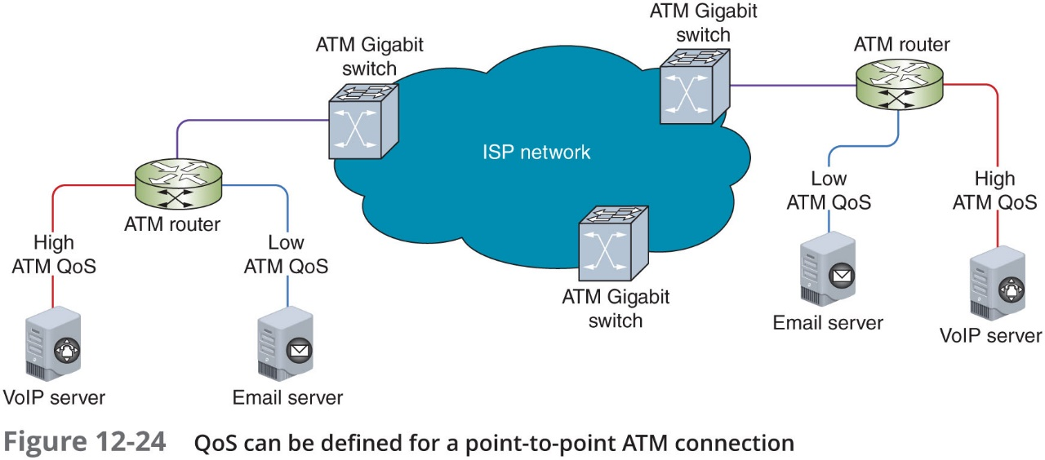
A T M (Asynchronous Transfer Mode) (3 of 3)

Slide 41
M P L S (Multiprotocol Label Switching) (1 of 2)
M P L S:
Enables multiple types of Layer 3 protocols to travel over any one of several connection-oriented Layer 2 protocols
Can handle various types of payloads
Often used by I S Ps on their own networks for moving traffic from one customer site to another
Can use packet-switched technologies over traditionally circuit-switched networks
M P L S labels include information about where the router should forward the message next
Include prioritization information

Slide 42
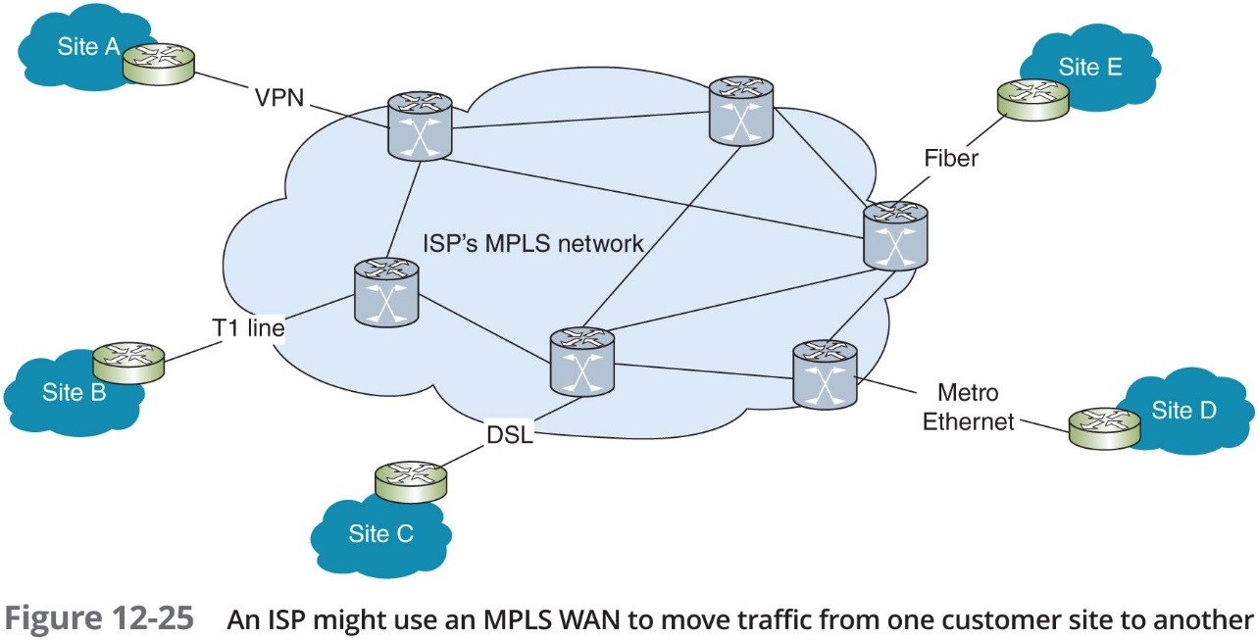
M P L S (Multiprotocol Label Switching) (2 of 2)

Slide 43
Wireless WANs
Wireless WANS
Specifically designed for high-throughput; long-distance digital data exchange

Slide 44
Cellular (1 of 4)
Initially designed for analog phone service
Today it can deliver data and voice
Cellular technology generations:
1G: analog
2G: digital transmission up to 240 Kbps
3G: data rates up to 384 Kbps
Data communications use packet switching
4G: all-I P, packet switched network for data and voice
Specifies throughputs of 100 Mbps for fast-moving clients; 1 Gbps for slow-moving clients
5G: don’t exist yet
Expect 5G devices to offer download speeds of up to 20 Gbps and upload speeds of 10 Gbps

Slide 45
Cellular (2 of 4)
Use one of two competing voice technologies:
G S M (Global System for Mobile Communications)
C D M A (Code Division Multiple Access)
Network infrastructure:
Cells served by antenna and base station
Controller assigns mobile clients frequencies
Cell size depends on:
Network’s access method
Region’s topology, population, and amount of cellular traffic

Slide 46
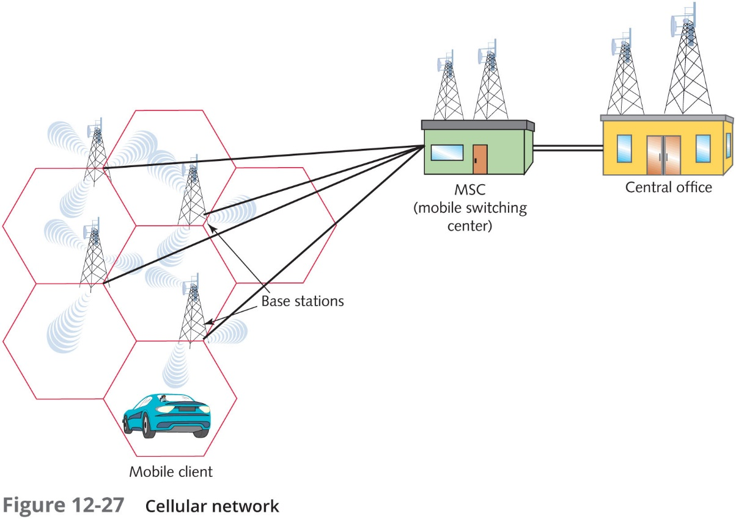
Cellular (3 of 4)

Slide 47
Cellular (4 of 4)
M S C (Mobile switching center)
Also called an M T S O
Each base station is connected to an M S C by a wireless link or fiber-optic cabling (see Figure 12-27 on previous slide)
Basic infrastructure:
H S P A+ (High Speed Packet Access Plus)
3G technology
L T E (Long-Term Evolution)
4G technology

Slide 48
Satellite (1 of 4)
Originally used to transmit telephone and television signals across the Atlantic Ocean
Today, satellites are used for transmitting consumer voice, video, music, and data
Satellite orbits:
Geosynchronous Earth orbit (G E O)
Satellites orbit at same rate Earth turns
Most popular
Uplink/Downlink
Satellite transponder transmits signal to Earth-based transmitter
Typical satellite
24–32 transponders
Unique downlink frequencies
Frequencies, as well as satellite’s orbit location are assigned and regulated by the F C C

Slide 49
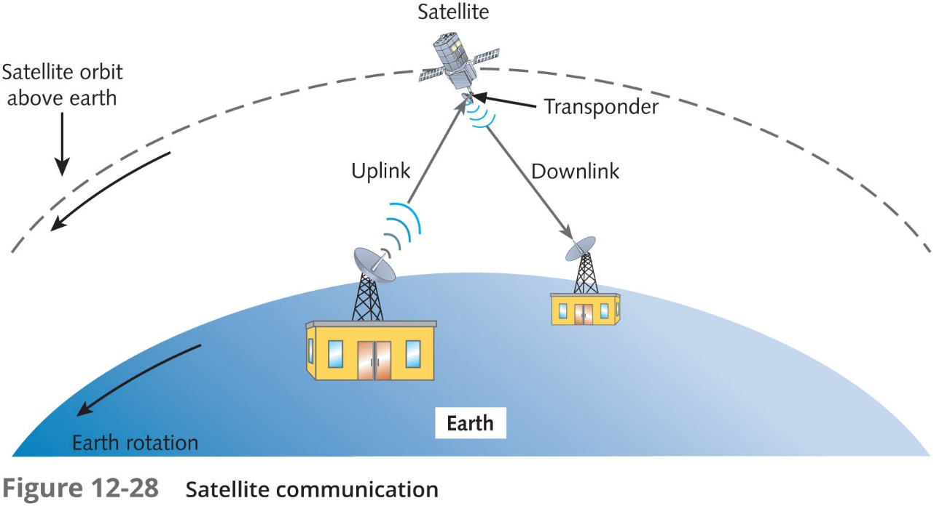
Satellite (2 of 4)

Slide 50
Satellite (3 of 4)
Satellites transmit and receive signals in any of six frequency bands
Within each band, frequencies used for uplink and downlink differ
Table 12-5 Satellite frequency bands
Band | Frequency range
L-band | 1.5-2.7 GHz
S-band | 2.7-3.5 GHz
C-band | 3.4-6.7 GHz
K_{u} (“K-under band”) | 12-18 GHz
K-band | 18-27 GHz
K_{a}-band (“K-above band”) | 26.5-40 GHz

Slide 51
Satellite (4 of 4)
Satellite Internet services:
Subscriber uses small satellite dish antenna, receiver, or satellite modem
Exchanges signals with provider’s satellite network
Typically asymmetrical
Bandwidth shared among many subscribers
Throughput controlled by service provider
Typical downlink rates range from 2 to 3 Mbps
Uplink rates may reach 1 Mbps

Slide 52
Chapter Summary (1 of 4)
A proxy server acts as an intermediary between the external and internal networks
Thanks to a router’s A C L or access list, routers can decline to forward certain packets depending on their content
A firewall is a specialized device or software that selectively filters or blocks traffic between networks
An I D S (intrusion detection system) is a stand-alone device, an application, or a built-in feature running on a workstation, server, switch, router, or firewall, which is used to monitor network traffic
I D S, I P S, firewalls, and proxy servers all generate a great deal of data that is stored in logs and must be monitored and analyzed

Slide 53
Chapter Summary (2 of 4)
S T P (Spanning Tree Protocol) prevents traffic loops by calculating paths that avoid potential loops and blocking links that would complete a loop
Unused physical and virtual ports on switches and other network devices should be disabled until needed
Controlling users’ access to a network consists of three major elements: authentication, authorization, and accounting
With geofencing, G P S or R F I D data is sent to the authentication server to report the location of the device attempting to authenticate to the network
Systems generate many logs that can be used for troubleshooting and auditing
A N A C system employs a set of rules, called network policies, which determine the level and type of access granted to a device when it joins a network

Slide 54
Chapter Summary (3 of 4)
Kerberos is a cross-platform authentication protocol that uses key encryption to verify identity of clients and to securely exchange information after a client logs on to a system
Kerberos is an example of S S O (single sign-on)
The most popular A A A service is RADIUS (Remote Authentication Dial-In User Service)
T A C A C S+ (Terminal Access Controller Access Control System Plus) offers network administrators the option of separating the access, authentication, and auditing capabilities
W E P offered two forms of authentication, neither of which is secure: O S A (Open System Authentication) and S K A (Shared Key Authentication)

Slide 55
Chapter Summary (4 of 4)
T K I P was a quick fix, designed more as an integrity check for W E P transmissions than as a sophisticated encryption protocol
C C M P improves wireless security for newer devices that can use W P A2
The Personal versions of W P A and W P A2 are sometimes referred to as W P A-P S K
The Enterprise versions of W P A and W P A2 implement additional security measures

